Slide 1
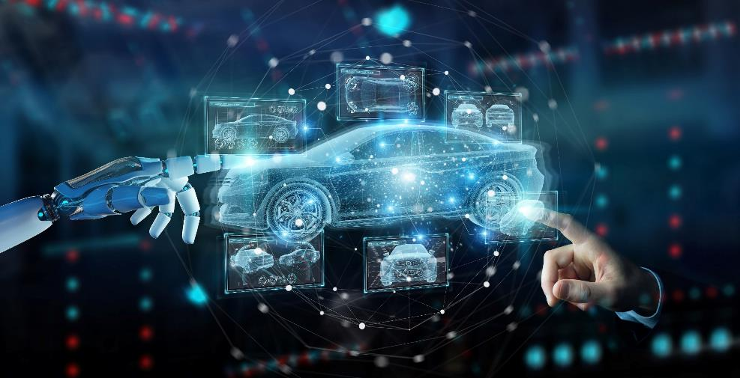
Introducing the role of host for the CEI conference in 2027
Notes:
Image source: Altengt. (2026, January 12).
https://www.altengt.com/images/automotive_funcational_safety/functional_safety_s.jpg

Slide 2


Main Theme of 2027 Conference: Sustainable Mobility, Natural and Cultural Heritage
Sub-themes:
Green vehicles and transport
Automatisation
Robotics
Humanoid robots and AI
in the present and future
Built and natural environment
Notes:
Image source: Blueandgreentomorrow. (2026, January 12).
https://blueandgreentomorrow.com/wp-content/uploads/2024/08/eco-friendly-car-ideas.jpg

Slide 3

Hungarian CEI logo (designed by Ervin, István and Tamás)
The meanings of our symbols:
Puli: ancient Hungarian sheperd dog
Tulip fountain: the petals are in the
national flag colours
In the middle: CEI symbol
In the background: the Earth
Notes:
Image source: Own work.

Slide 4
General Board of Hungarian CEI
Balaicz Zoltán – Mayor of Zalaegerszeg City with County Rights
Kajári Attila – Director of Zalaegerszeg District Centre for Public
Education
Molnár Katalin – Financial Leader of Zalaegerszeg District Centre for
Public Education
Dr. Háry András - Head of the JKK-ZalaZONE Vehicle Industry Test Center,
CEO of ZalaZONE Industrial Park Ltd., Managing Director of ZalaZONE
Science Park Ltd.

Slide 5
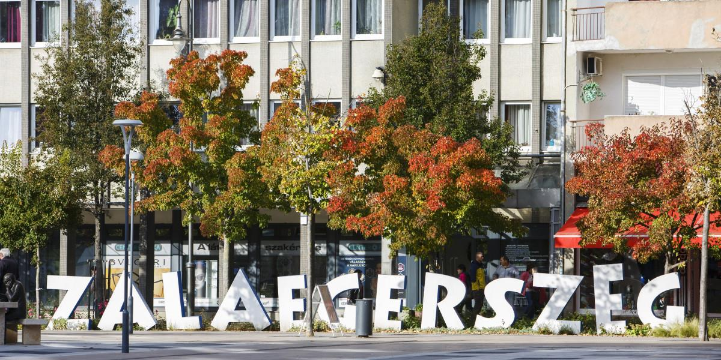
Our city via images
Notes:
Image source: Infostart. (2026, January 12).
https://infostart.hu/images/site/articles/lead/2023/05/1684510448-OInPjitTY_md.jpg

Slide 6
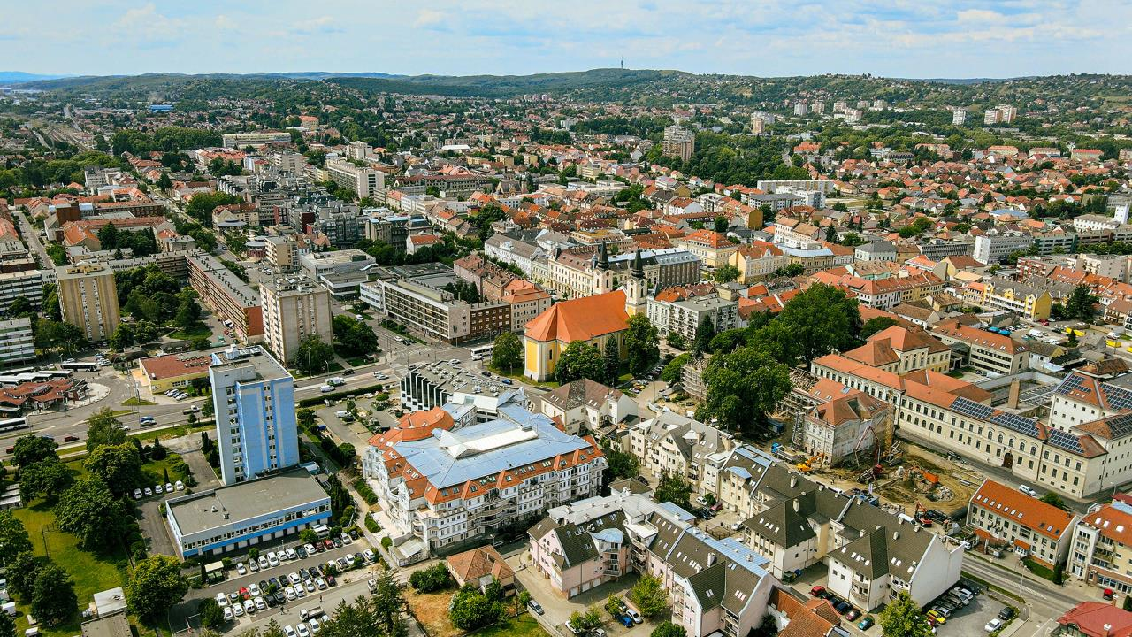
Notes:
Image source: Zalaegerszeg. (2026, January 12).
https://zalaegerszeg.hu/wp-content/uploads/2020/04/zegwebcity.jpg

Slide 7
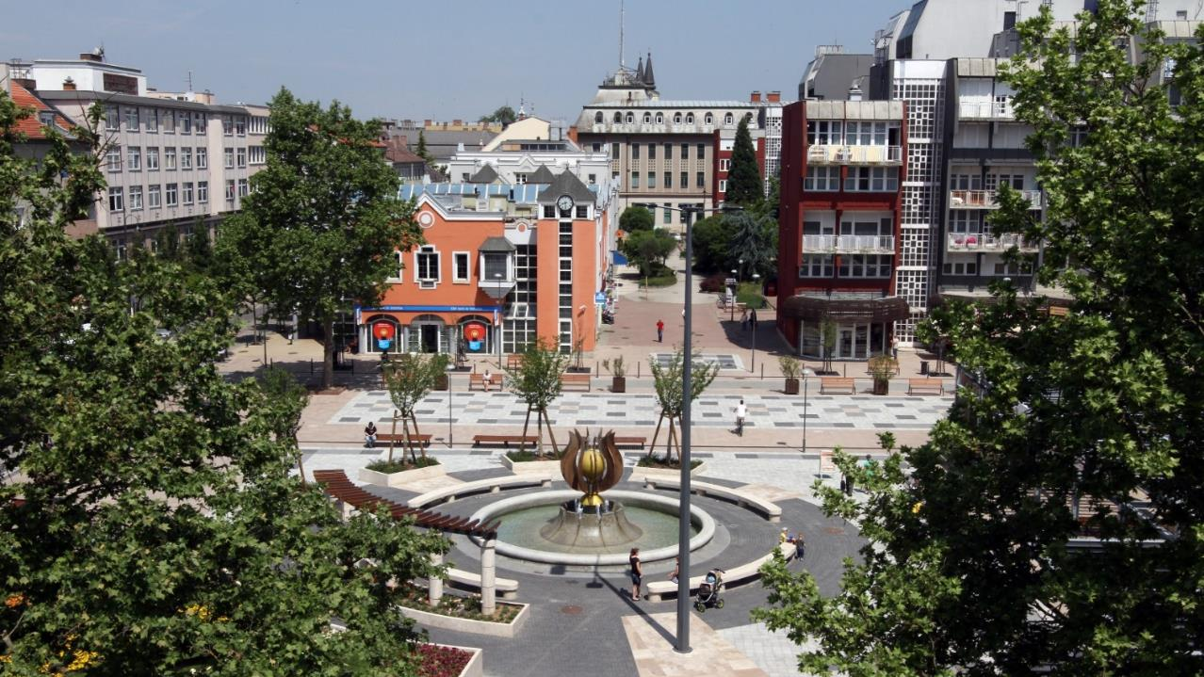
Dísz Square with the Tulip fountain
Notes:
Image source: E-city. (2026, January 12).
https://e-city.hu/documents/20126/163404/disz_ter+%281%29.jpg

Slide 8
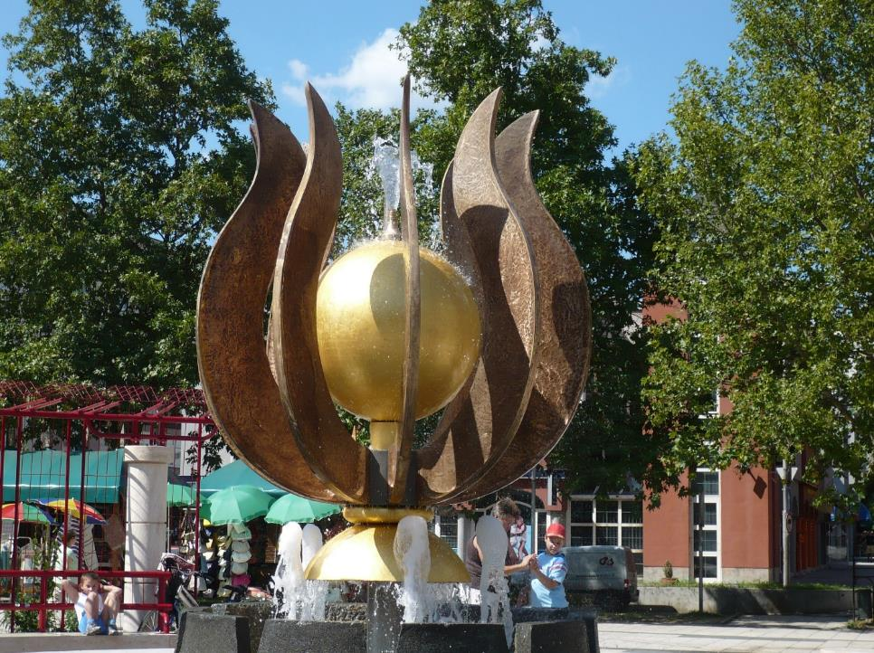
Tulip fountain
Notes:
Image source: Wikimedia. (2026, January 12).
https://upload.wikimedia.org/wikipedia/commons/e/e8/Zalaegerszeg%2C_D%C3%ADsz_t%C3%A9r%2C_Parada_placo.jpg

Slide 9
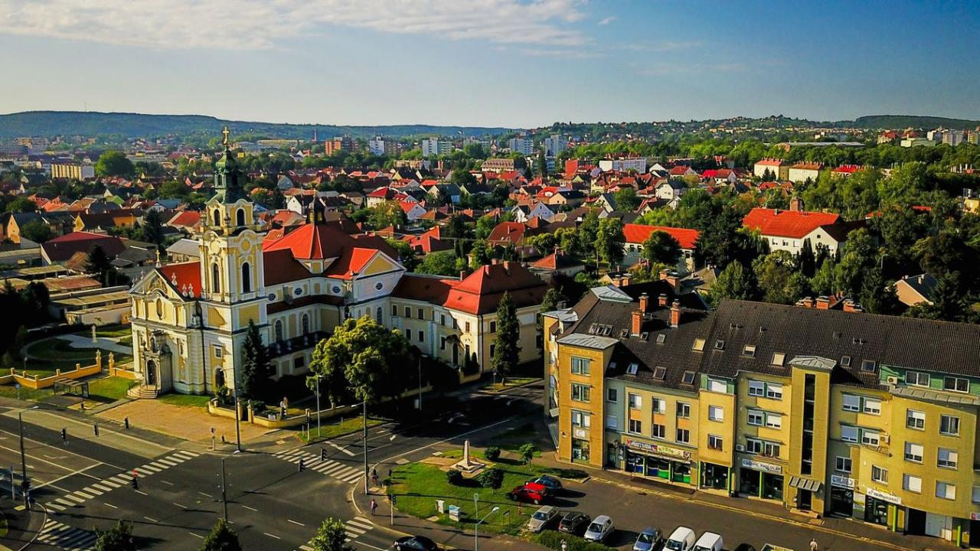
Heart of Jesus Roman Catholic Church
Notes:
Image source: Zaol. (2026, January 12).
https://cdn.zaol.hu/2025/10/1eZ6s1aYoRHCE42K97eqB8dZ9H_7ft6AwGFRcRC_nt0/fill/1200/675/no/1/aHR0cHM6Ly9jbXNjZG4uYXBwLmNvbnRlbnQucHJpdmF0ZS9jb250ZW50L2FjOWM3NDE5YTFkNTQ1M2VhYzEwYzQwNTk0ODcyMmFl.jpg

Slide 10
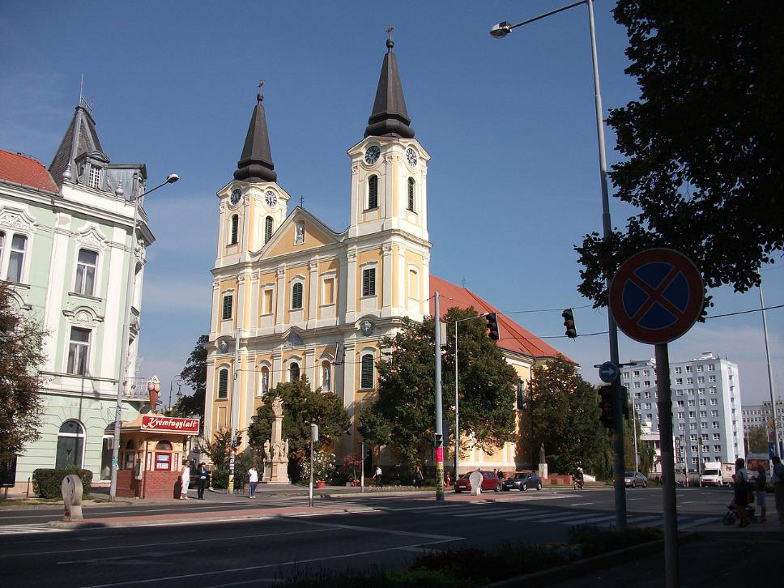
Marie Magdalena Roman Catholic Church
Notes:
Image source: Wikimedia. (2026, January 12).
https://upload.wikimedia.org/wikipedia/commons/thumb/b/bc/R._k._pl%C3%A9b%C3%A1niatemplom_%2811066._sz%C3%A1m%C3%BA_m%C5%B1eml%C3%A9k%29_5.jpg/1200px-R._k._pl%C3%A9b%C3%A1niatemplom_%2811066._sz%C3%A1m%C3%BA_m%C5%B1eml%C3%A9k%29_5.jpg

Slide 11
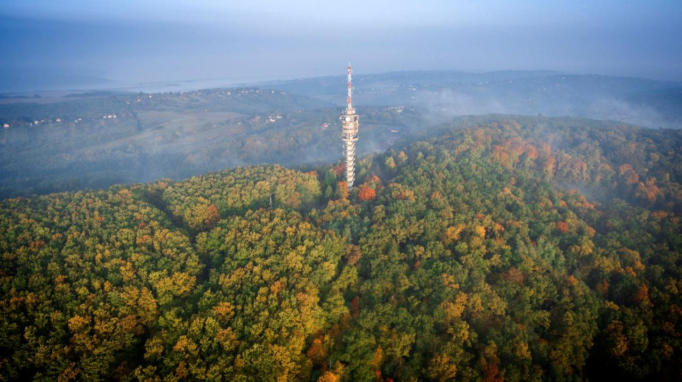
TV tower on the top of Bazita hill
Notes:
Image source: E-city. (2026, January 12).
https://e-city.hu/documents/20126/163939/TV-torony+(1).jpg

Slide 12
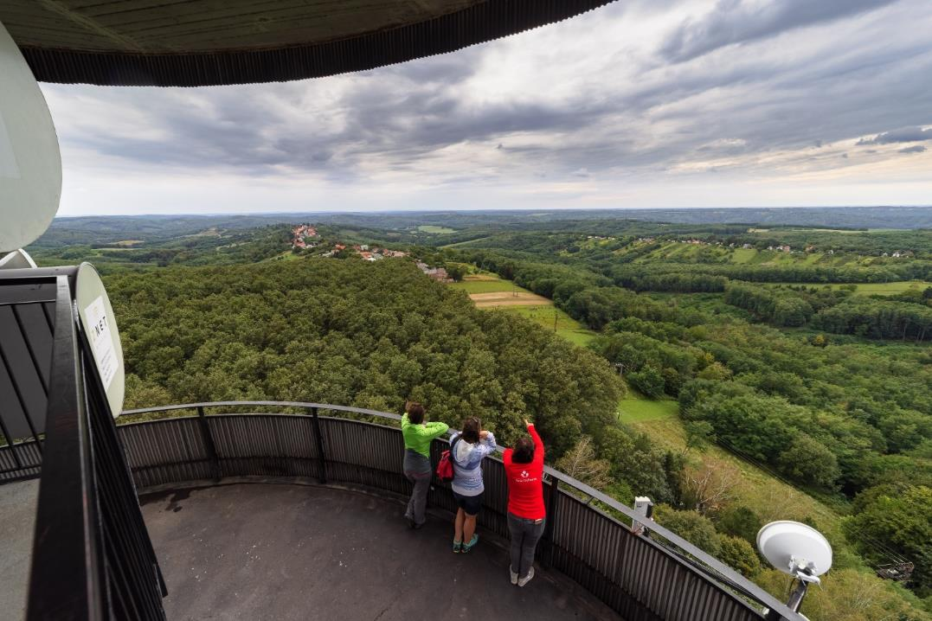
The view from the highest lookout point on TV tower
Notes:
Image source: Facebook – Természetjáró. (2026).
https://www.facebook.com/photo/?fbid=606849038707977

Slide 13
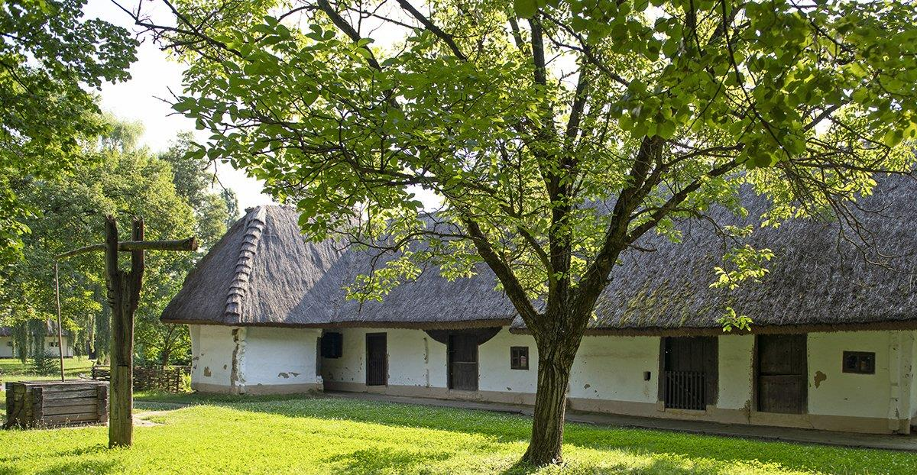
Göcsej Village Museum (Skanzen)
Notes:
Image source: Zegimuzeumok. (2026, January 12).
https://zegimuzeumok.hu/wp-content/gallery/kalocfai-lakohaz-udvara/gocseji-skanzen-04b-kalocfai-lakohaz.jpg

Slide 14
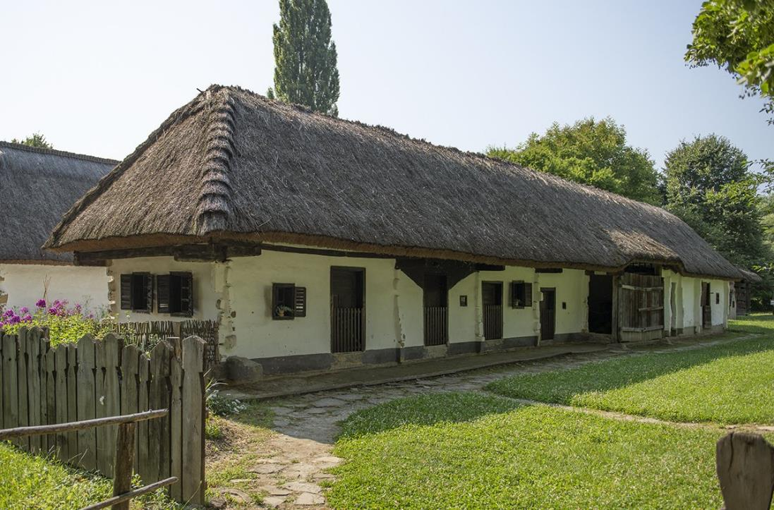
Thatched (cane) roof of peasant family
Notes:
Image source: Zegimuzeumok. (2026, January 12).
https://zegimuzeumok.hu/wp-content/gallery/zalalovoi-hosszuhaz-udvara/gocseji-skanzen-14-zalalovoi-hosszuhaz.jpg

Slide 15
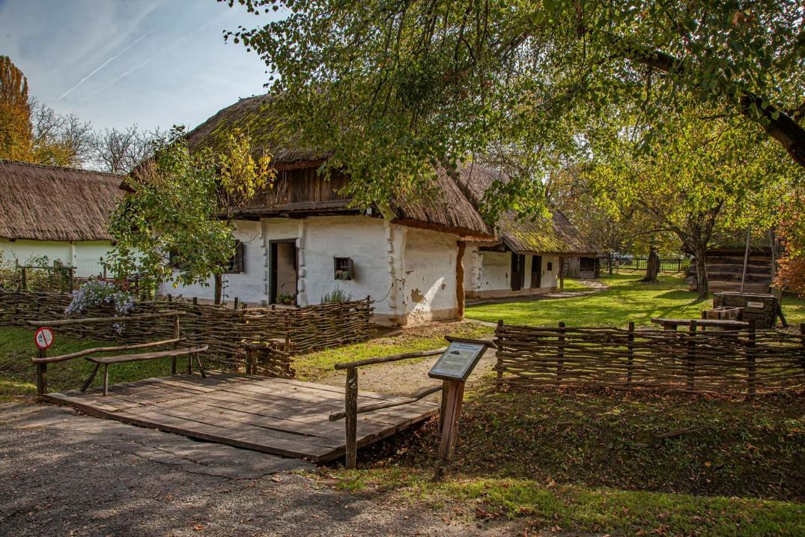
Notes:
Image source: Csodalatosmagyarorszag. (2026, January 12).
https://csodalatosmagyarorszag.hu/wp-content/uploads/2024/10/zalaegerszeg-gocseji-falumuzeum-skanzen-osz-jegyvasarlas8-csodalatosmagyarorszag.jpg

Slide 16
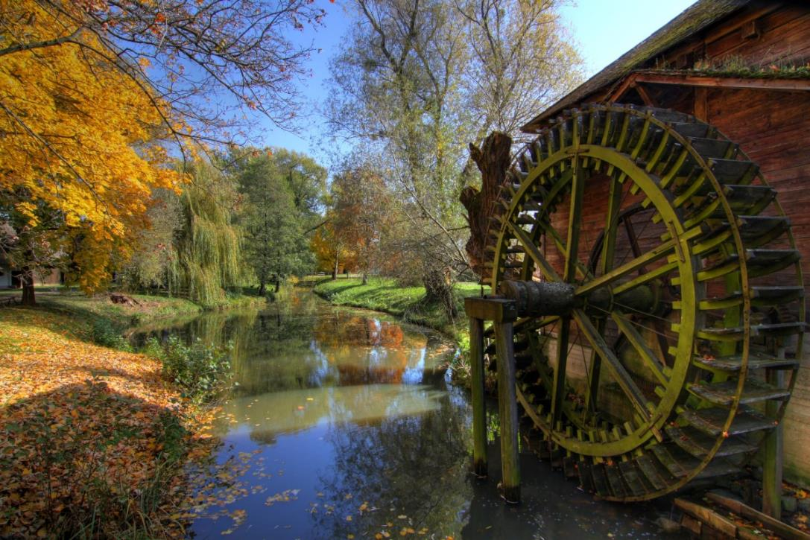
Water mill
Notes:
Image source: Zalaegerszegturizmus. (2026, January 12).
https://zalaegerszegturizmus.hu/wp-content/uploads/2015/05/Gocseji-Falumuzeum.jpg

Slide 17
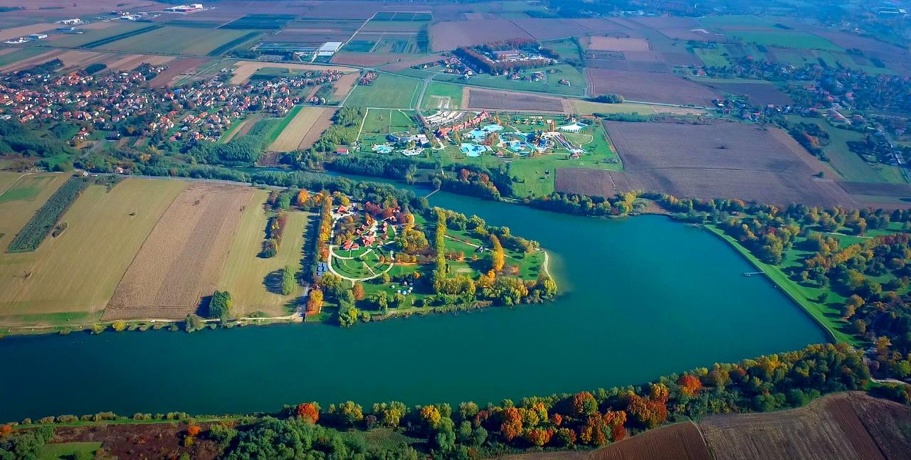
Lake Gébárt and its surroundings
Notes:
Image source: Facebook – Tourinform Zalaegerszeg. (2026).
https://www.facebook.com/photo/?fbid=1082008930593837

Slide 18
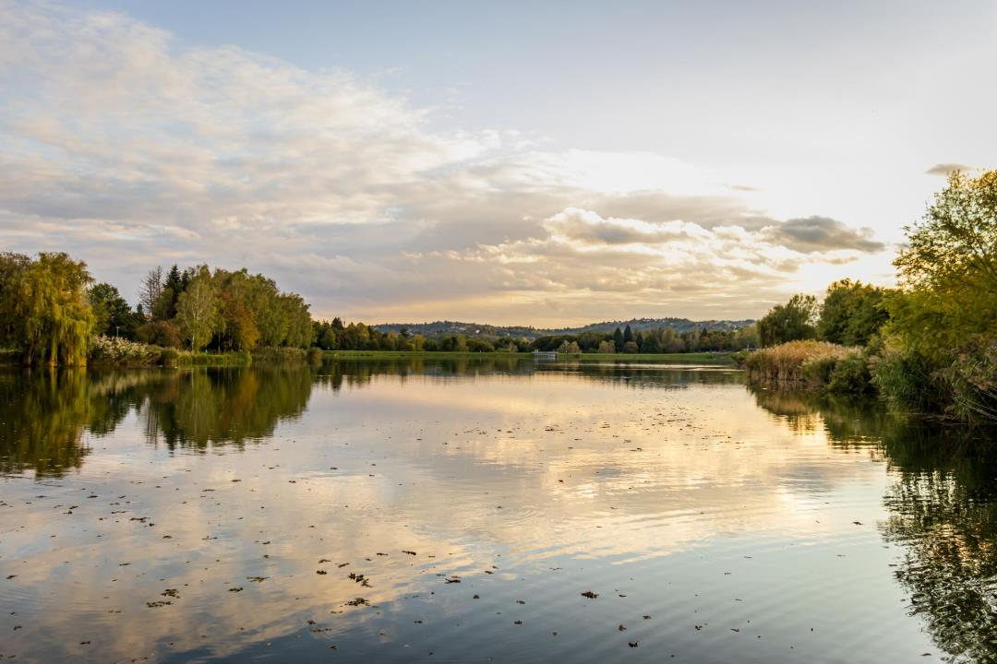
Swimming and fishing lake of Gébárt
Notes:
Image source: Szallas. (2026, January 12).
https://i.szalas.hu/pois/6461/original/34372.jpg

Slide 19
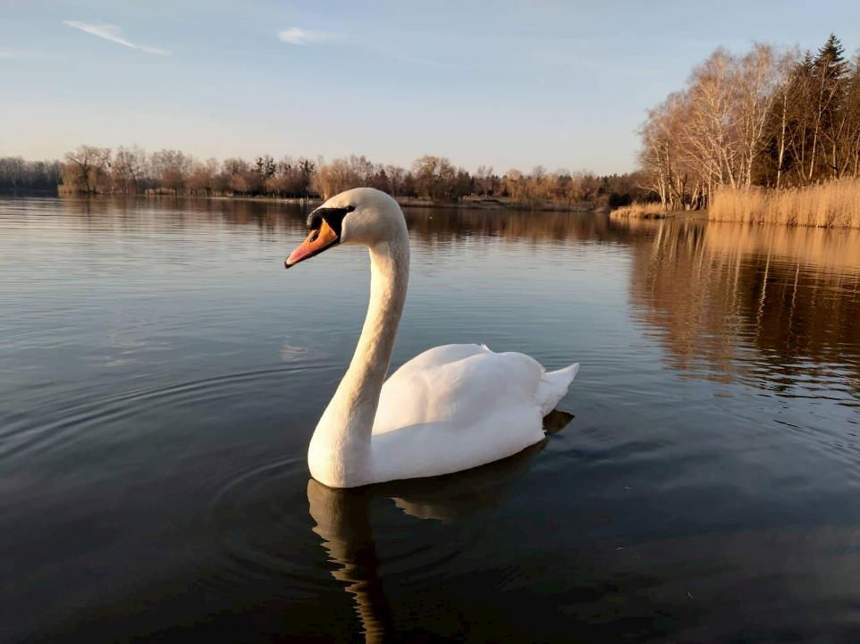
Swan (a permanent guest of the lake)
Notes:
Image source: Szallas. (2026, January 12).
https://i.szalas.hu/pois/6461/original/22224.jpg

Slide 20
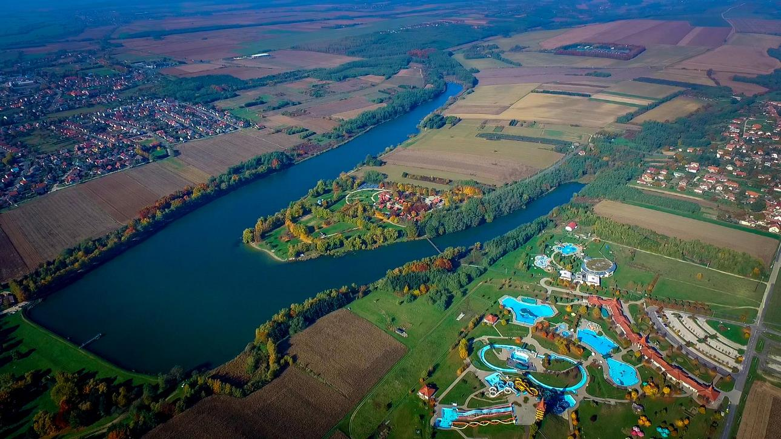
Lake Gébárt and AquaCity (theme park)
Notes:
Image source: Turistamagazin. (2026, January 12).
https://www.turistamagazin.hu/media/thumbs/mi/nd/en/minden-adott-hogy-a-termeszetjarok-kedvence-legyen-zala-60e8a238-7935954.jpeg

Slide 21
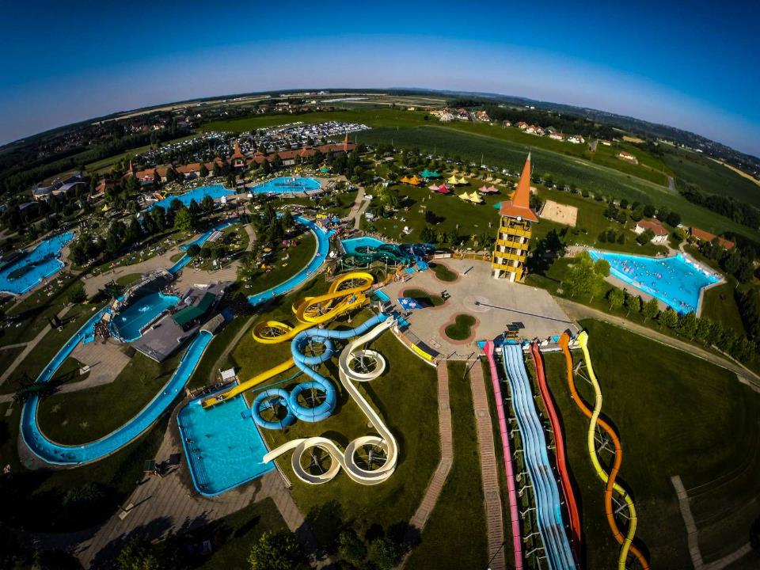
AquaCity
Notes:
Image source: Magyarorszagom. (2026, January 12).
https://www.magyarorszagom.hu/upload/userupload/4/images/G0259383-3c_.jpg

Slide 22
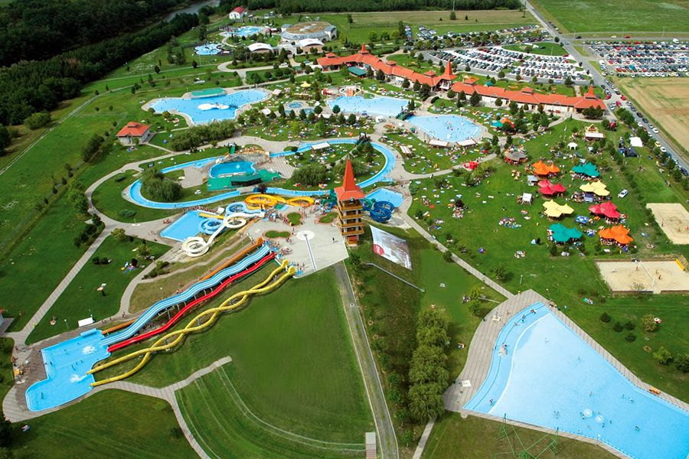
Notes:
Image source: Termalfurdo. (2026, January 12).
https://www.termalfurdo.hu/upload/images/Galeria/furdo/aquacity_zalaegerszeg/termalfurdo_aquacity_zalaegerszeg_1.jpg

Slide 23
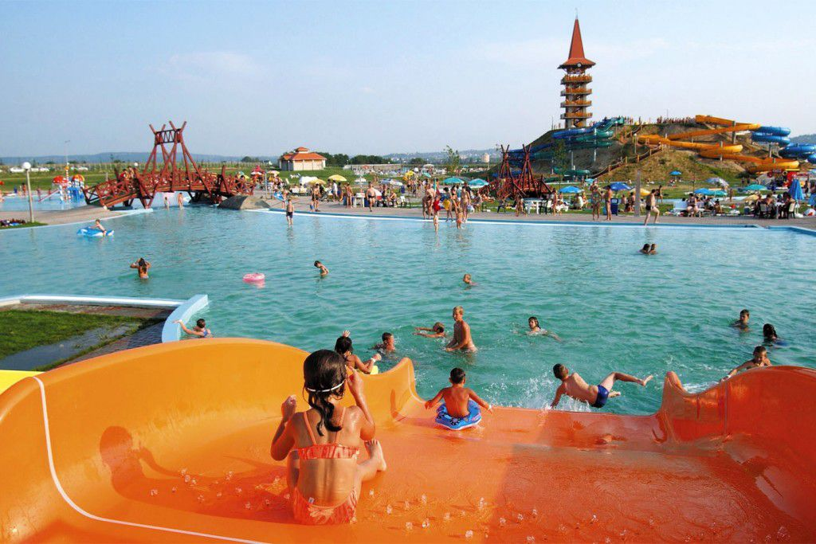
Notes:
Image source: Termalfurdo. (2026, January 12).
https://www.termalfurdo.hu/upload/images/Galeria/furdo/aquacity_zalaegerszeg/termalfurdo_aquacity_zalaegerszeg_6.jpg

Slide 24
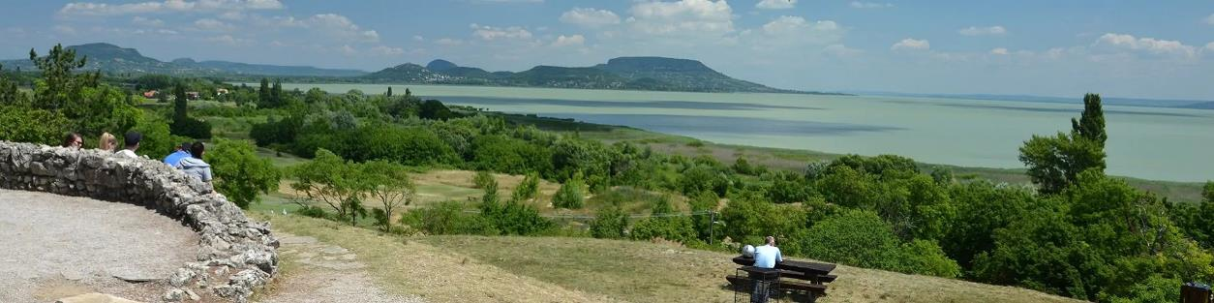
Places to visit on Field Trips
Beautiful Viewpoint of Balatongyörök
Small Balaton Educational Trails
Balatonboglár Sphere Lookout
Castle ruins of Szigliget (historical monument)
Optionally: Hévíz - Keszthely and their surroundings
Notes:
Image source: Balatongyorok. (2026, January 12).
https://balatongyorok.hu/wp-content/uploads/2019/09/szepkilato_fejlec-1.jpg

Slide 25
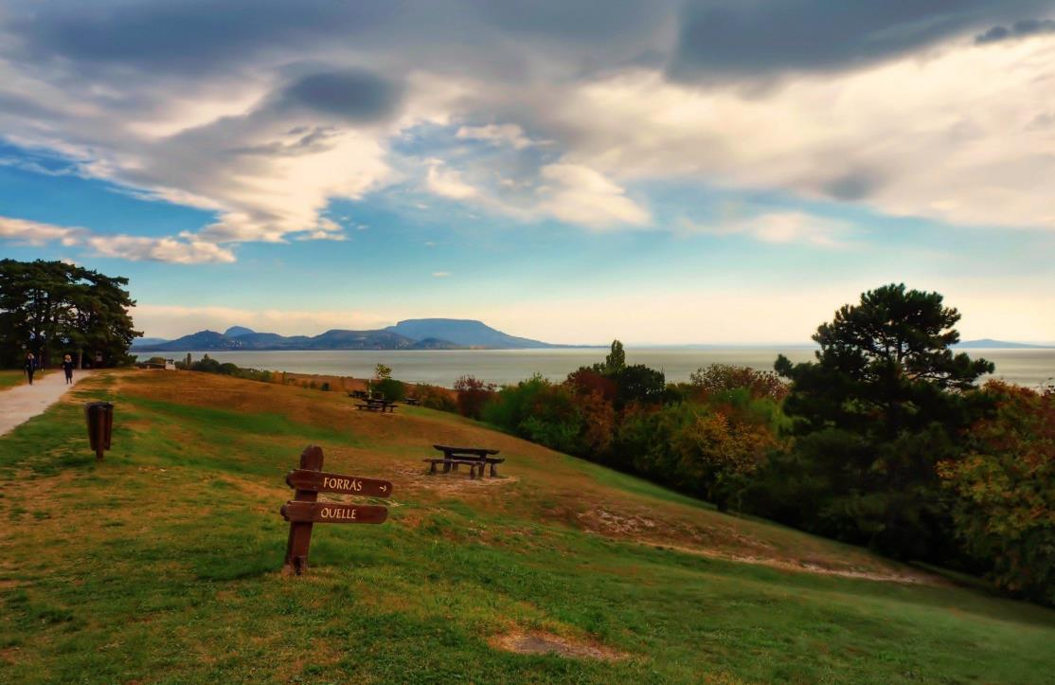
Beautiful Viewpoint of Balatongyörök
Notes:
Image source: Balatongyorok. (2026, January 12).
https://balatongyorok.hu/wp-content/gallery/szepkilato/szepkilato1.jpg

Slide 26
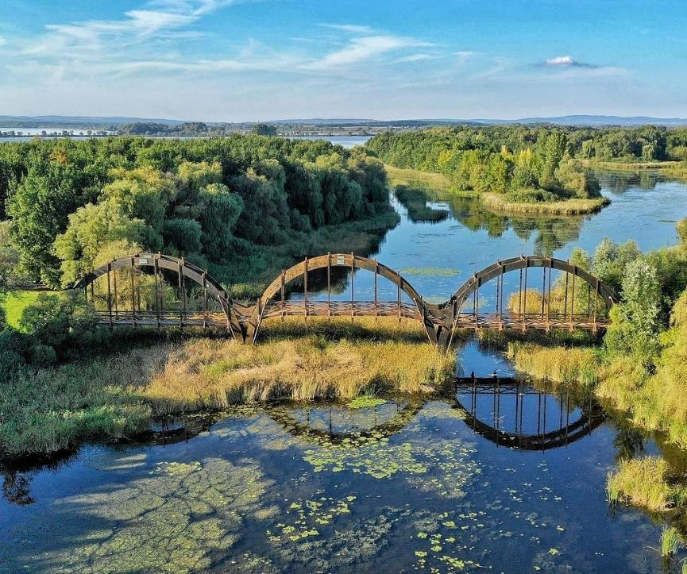
Small Balaton Educational Trails
(tourist guided programs by rangers)
Notes:
Image source: Heviz. (2026, January 12).
https://www.heviz.hu/file/news/1483/gallery/big/96215217_109172000789301_7731198633269264384_n.jpg

Slide 27
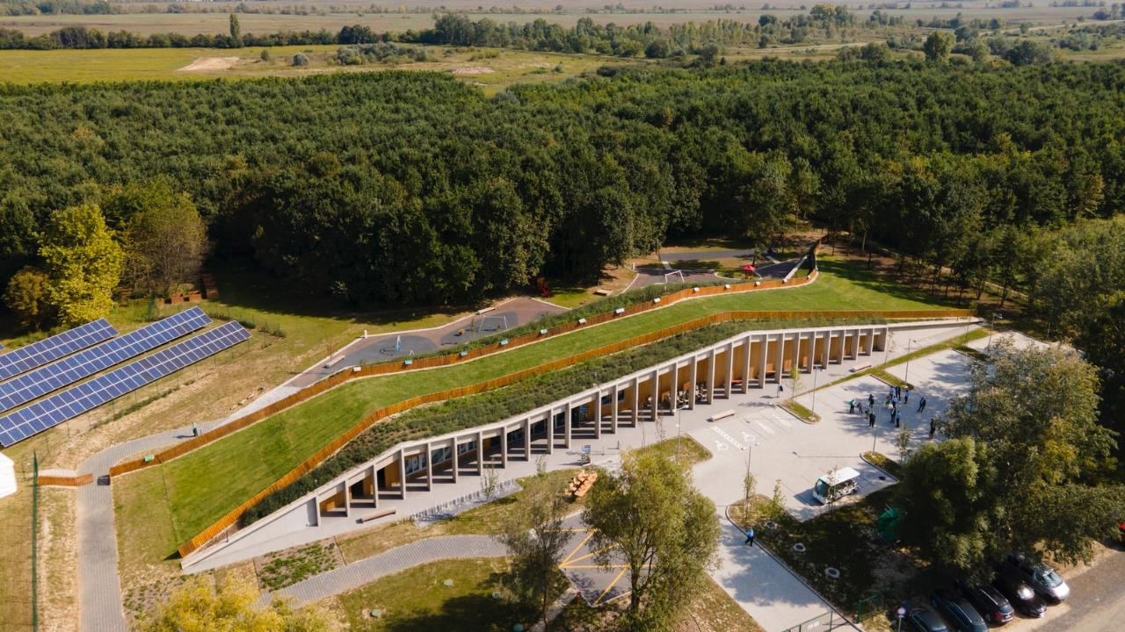
Visitor Centre (with a lot of permanent exhibitions about the wild life and plants of Lake Balaton)
Notes:
Image source: Csodalatosborok. (2026, January 12).
https://csodalatosborok.hu/wp-content/uploads/2020/09/keszthely-fenekpuszta-kis-balaton-latogatokozpont-csodalatosbalaton.jpg

Slide 28
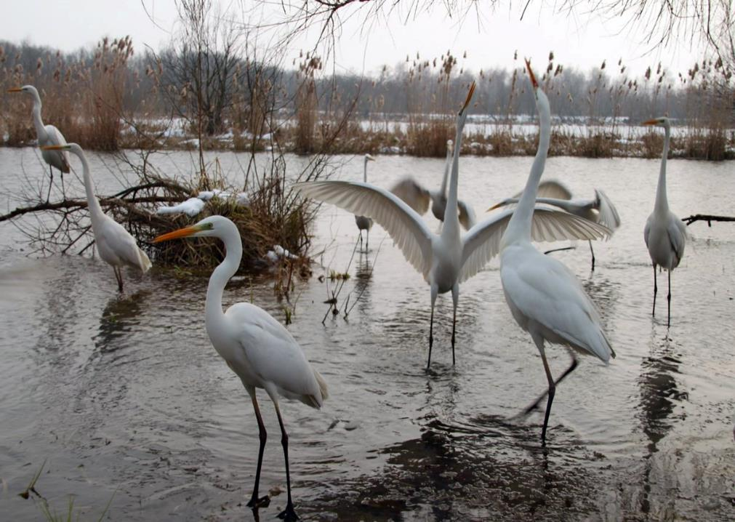
Great White Egrets (protected bird)
Notes:
Image source: Erdelyalbum. (2026, January 12).
https://erdelyalbum.hu/wp-content/uploads/2021/04/7-az-elelemert-kuzdo-harc-a-nagy-kocsagoknal-is-megvan.jpg

Slide 29
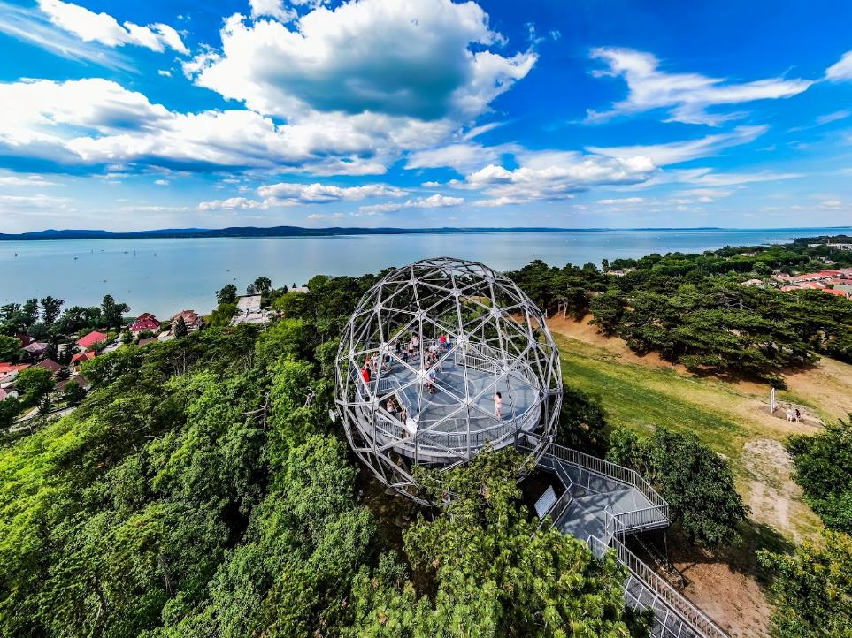
Sphere Lookout (Balatonboglár)
Notes:
Image source: Facebook – Szeretem a Balatont - Bakancslistás helyek. (2026).
https://www.facebook.com/photo?fbid=1015053923995292

Slide 30
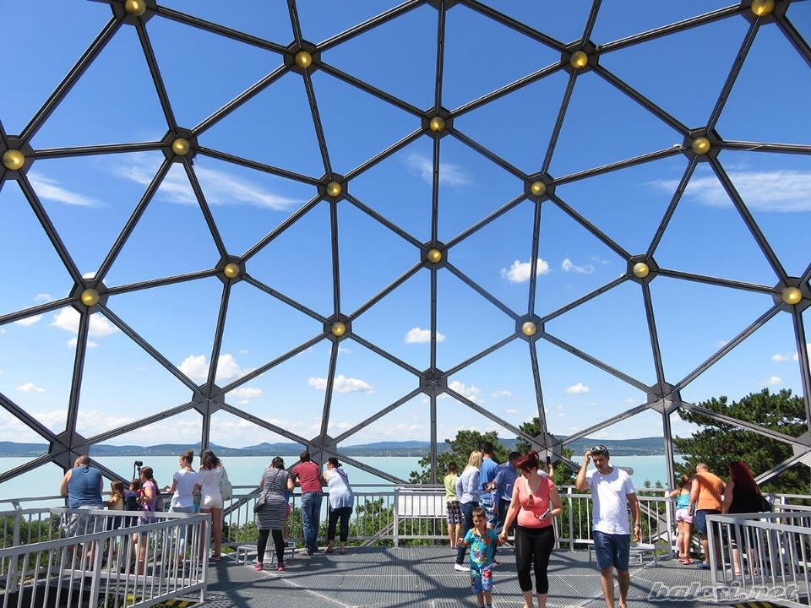
Notes:
Image source: Balcsi. (2026, January 12).
https://balcsi.net/wp-content/uploads/2020/02/balatonboglar_gombkilato_15.jpg

Slide 31
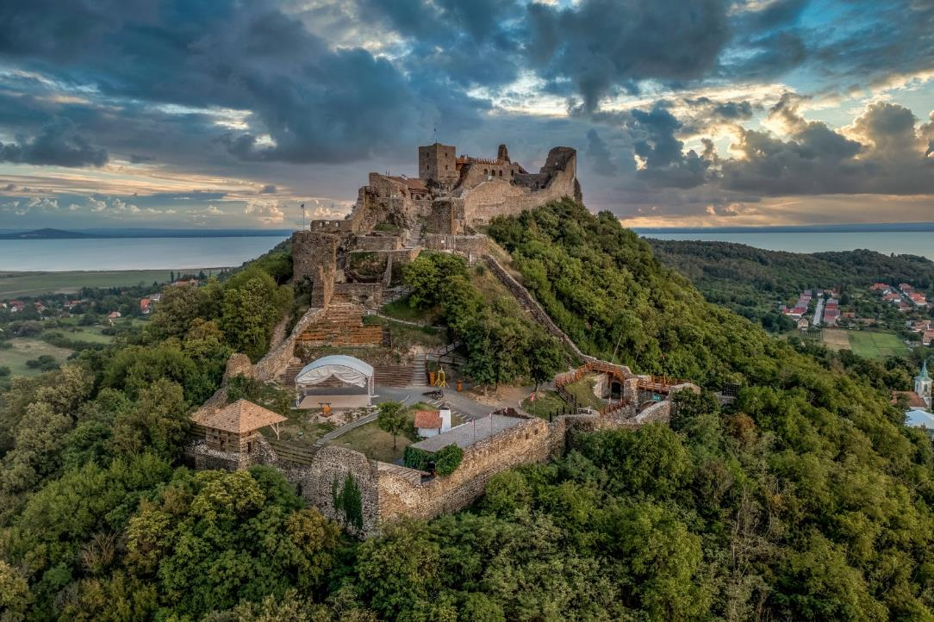
Castle Ruin of Szigliget (medieval fortress,
mountain climbing tours)
Notes:
Image source: Likebalaton. (2026, January 12).
https://likebalaton.hu/wp-content/uploads/2024/10/9320738shutterstock2136688393-scaled.jpg

Slide 32
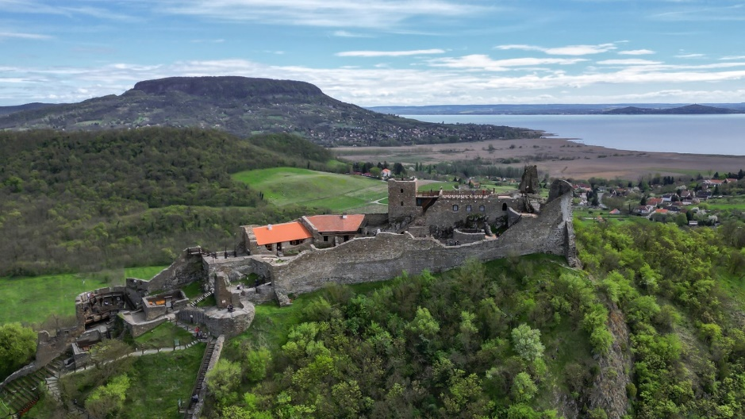
Notes:
Image source: 24. (2026, January 12).
https://ng.24.hu/uploads/2024/04/szigliget.jpg

Slide 33
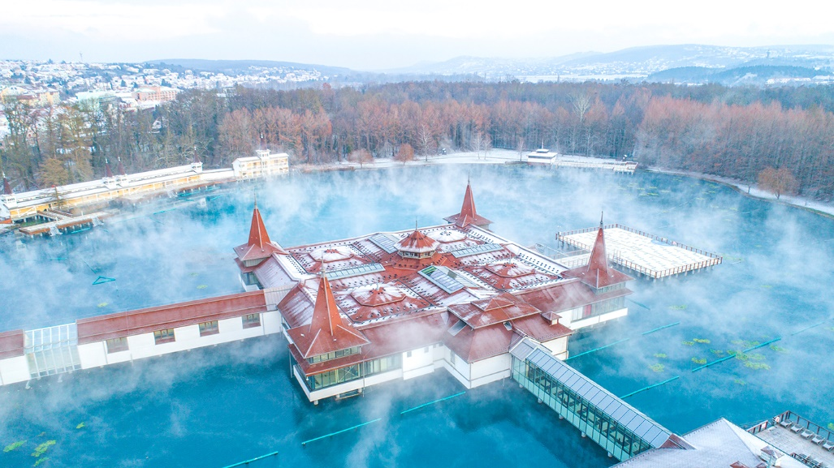
Hévíz Lake with thermal water
Notes:
Image source: Csodalatosmagyarorszag. (2026, January 12).
https://csodalatosmagyarorszag.hu/wp-content/uploads/2018/03/hevizi-tofurdo-termalto-gyogyfuro-heviz-to-latnivalo-spa-csodalatosmagyarorszag.jpg

Slide 34
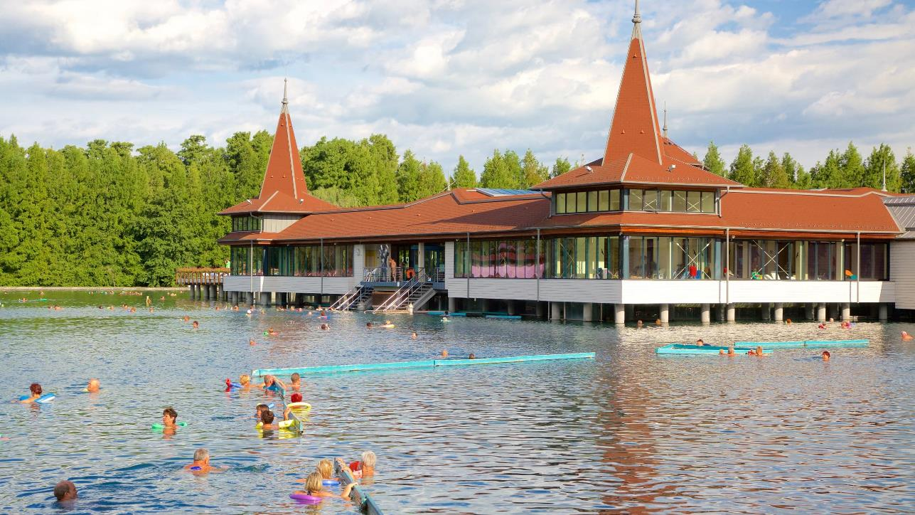
Central building on the middle of the lake with tourist apartments
Notes:
Image source: Trvl-media. (2026, January 12).
https://images.trvl-media.com/place/6102306/8248d3e0-f034-4084-94d0-c95ee653a5f9.jpg

Slide 35
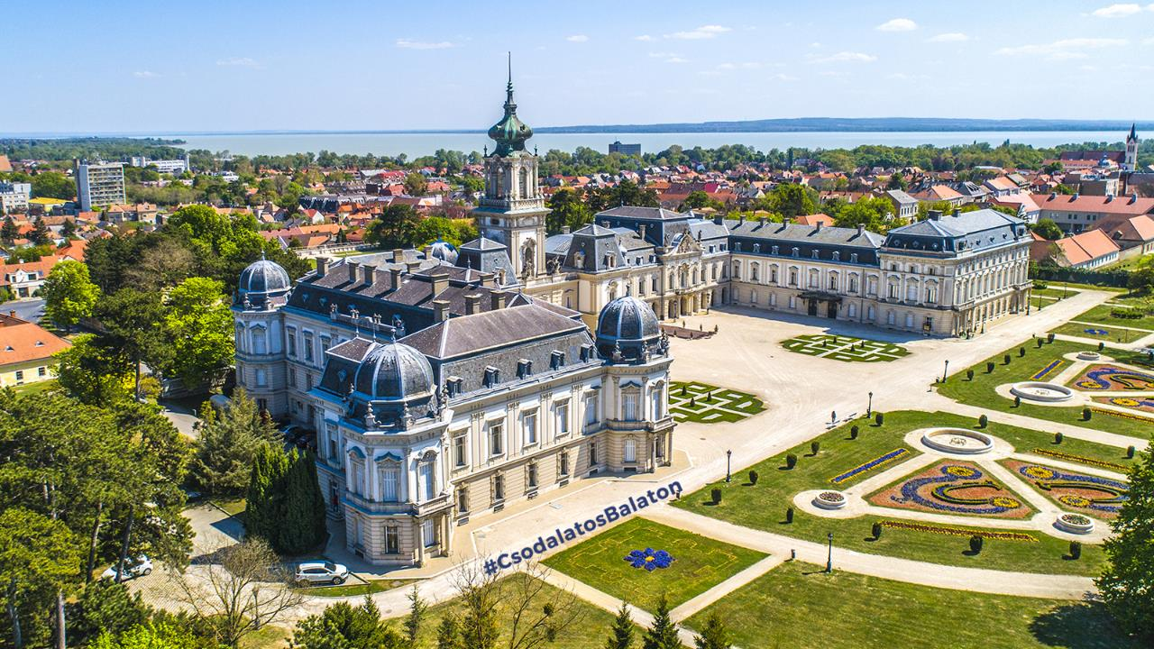
Festetics Castle and its Baroque Garden (Keszthely)
Notes:
Image source: Csodalatosmagyarorszag. (2026, January 12).
https://csodalatosbalaton.hu/wp-content/uploads/2021/04/festetics-kastely-keszthely-helikon-kastelymuzeum-dronfoto-csodalatosbalaton-csodalatosmagyarorszag.jpg

Slide 36
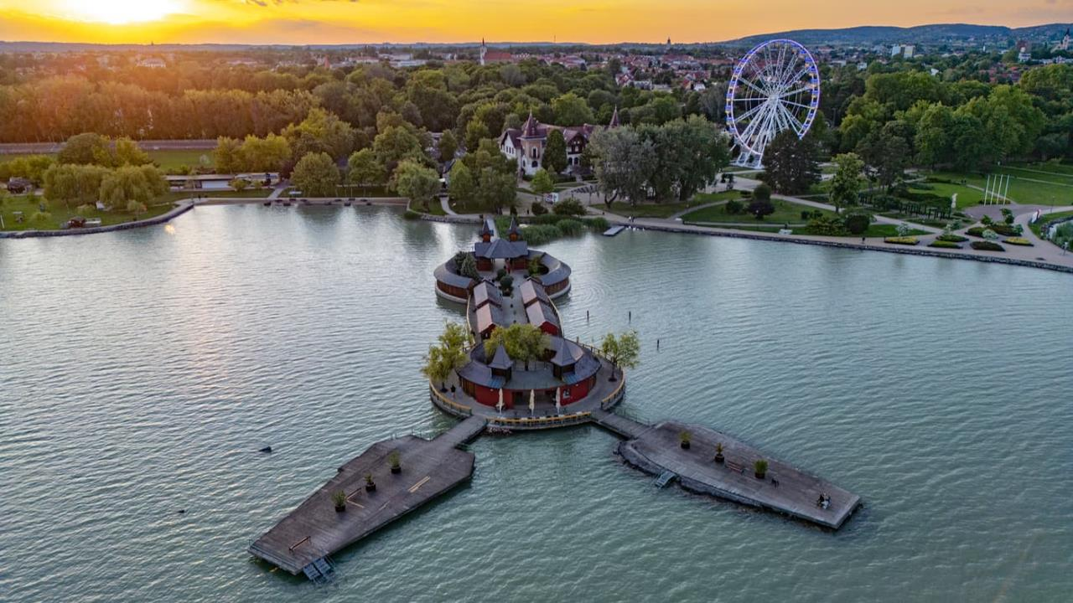
The port of Keszthely City
Notes:
Image source: Facebook – Turistička agencija TIM travel. (2026).
https://www.facebook.com/tatimtravel/photos/d41d8cd9/1381798897290140/

Slide 37
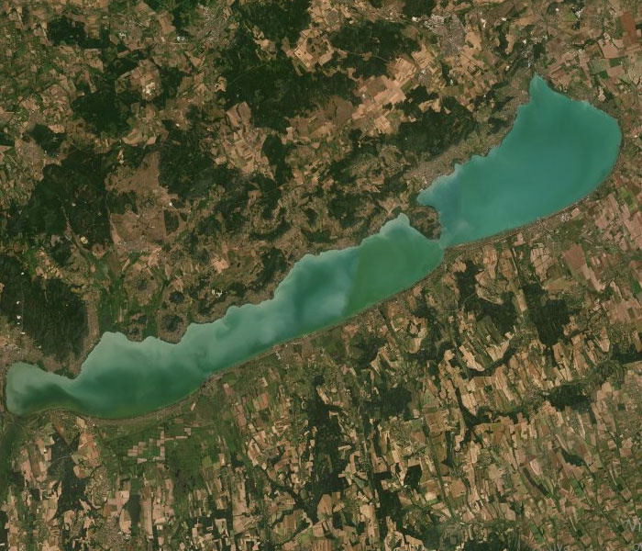
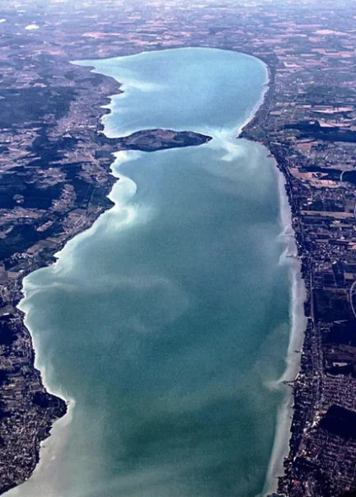
Satellite images of Lake Balaton
Notes:
Image source: Indexvas. (2026, January 12).
https://kep.cdn.indexvas.hu/1/0/3442/34426/344269/34426923_4ab77f229d750b83f25d85c4d0e8f63b_wm.jpg
Image source: Reddit – u/Classic_Butterfly276, r/hungary. (2026).
https://www.reddit.com/r/hungary/comments/1i3p0te/donal_trump_mindig_is_itt_volt_n%C3%A1lunk/

Slide 38
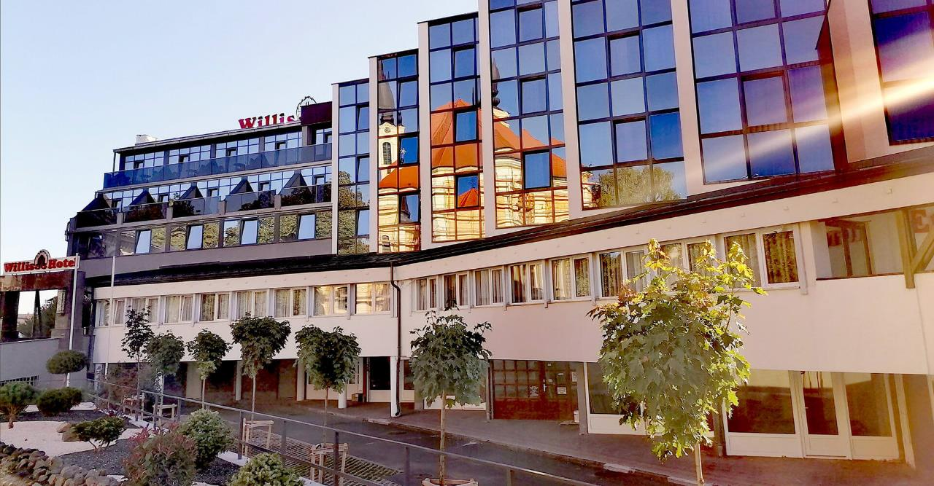
Accomodation: Hotel Willis and Hotel Bárány
Notes:
Image source: Willishotel. (2026, January 12).
https://zcms.hu/willishotelhu/img/gallery/e53e180aa37950701f1224acd34488ee.jpg

Slide 39
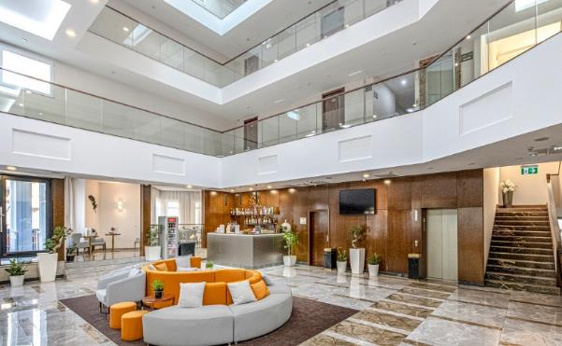
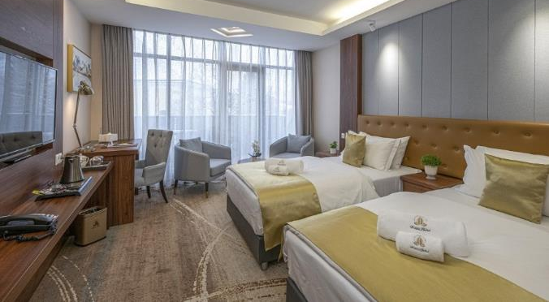
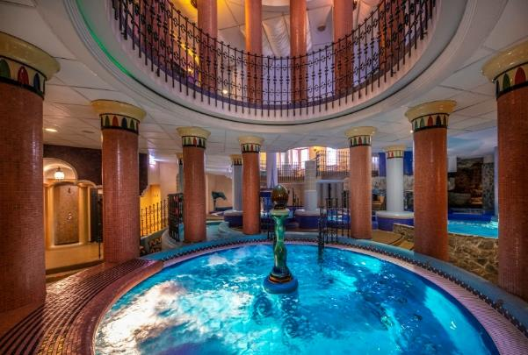
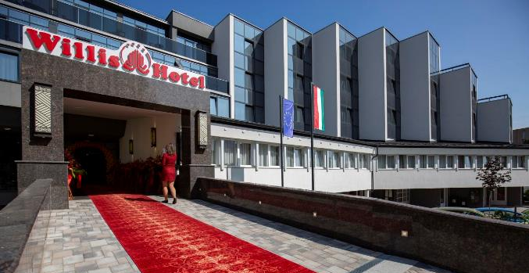
Notes:
Image source: Willishotel. (2026, January 12).
https://zcms.hu/willishotelhu/img/gallery/5acaf3c3c54654b40b538d62585c2113.jpg
Image source: Willishotel. (2026, January 12).
https://zcms.hu/willishotelhu/img/gallery/7e1071d6d188ab8be47059059586938f.jpg
Image source: Willishotel. (2026, January 12).
https://zcms.hu/willishotelhu/img/gallery/fdae29cd177fcd58e72a7d13b23896eb.jpg
Image source: Turizmus. (2026, January 12).
https://turizmus.com/img-cache/w/i/l/l/i/willis1-archive-cikk-117-1724-cikk-1171724-1290-860-90-cr.webp

Slide 40
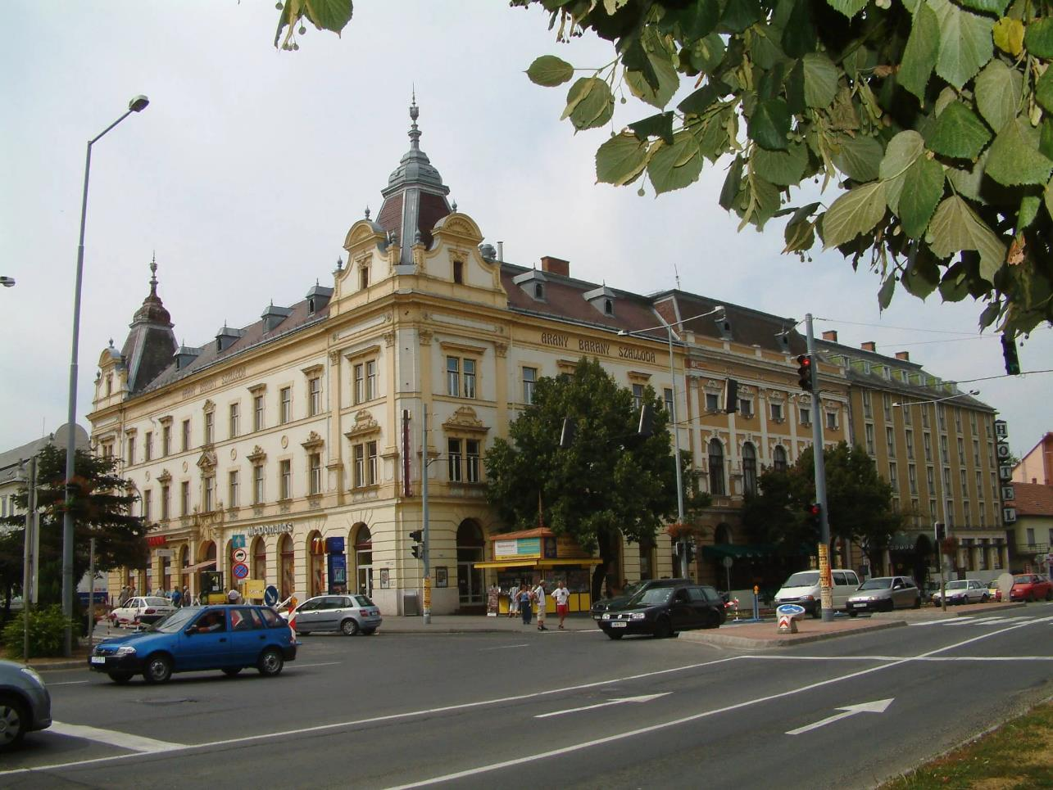
Notes:
Image source: Szallas. (2026, January 12).
https://i.szalas.hu/hotels/466649/original/2945853.webp

Slide 41
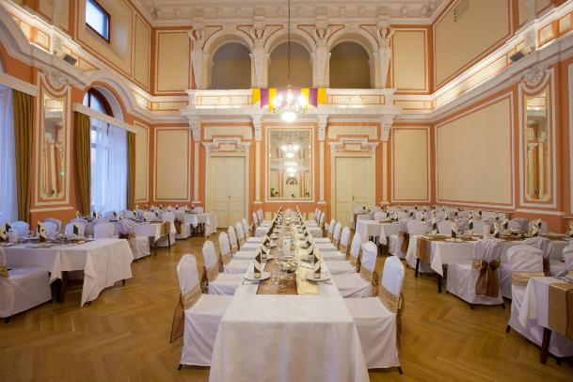
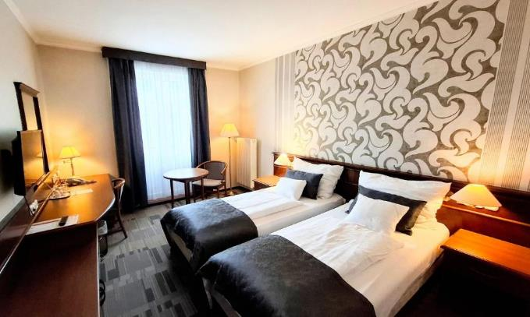
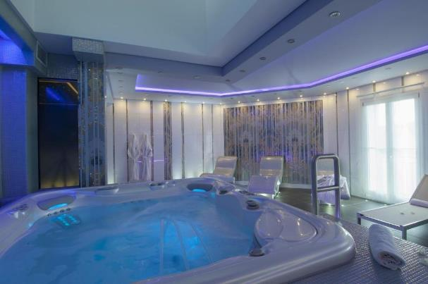
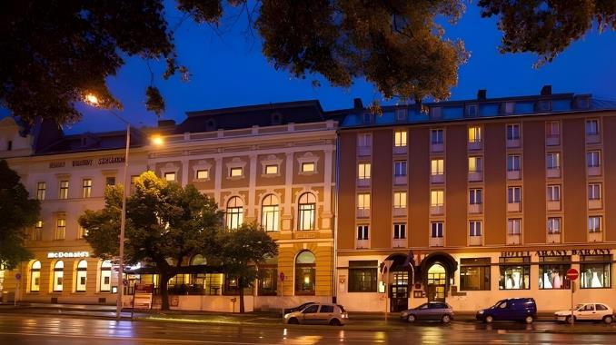
Notes:
Image source: Szallas. (2026, January 12).
https://i.szalas.hu/hotels/466649/original/3110700.webp
Image source: Booking.com – Arany Bárány Hotel. (2026).
https://www.booking.com/hotel/hu/arany-ba-ra-ny.hu.html
Image source: Aranybarany. (2026, January 12).
https://zcms.hu/aranybaranyhu/img/gallery/f813b1c5ef914637c9c15827f8a43f7e.jpg
Image source: Booking.com – Arany Bárány Hotel. (2026).
https://www.booking.com/hotel/hu/arany-ba-ra-ny.hu.html

Slide 42
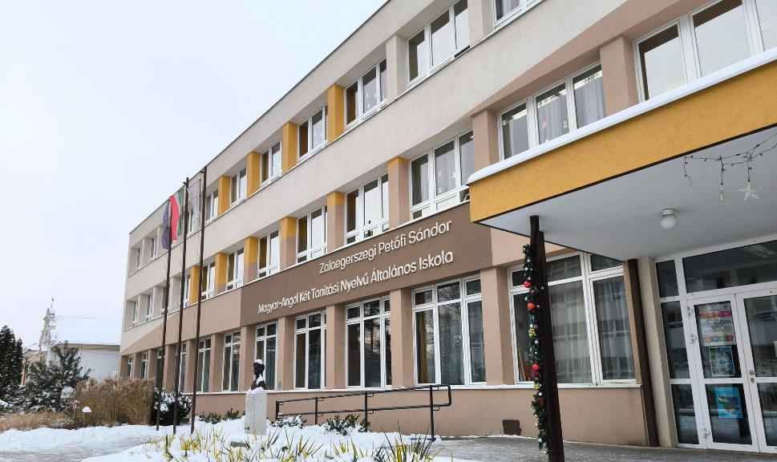
Schools: Petőfi Sándor Hungarian-English Bilingual School and Zrínyi Miklós Grammar School
Notes:
Image source: Own photo.

Slide 43
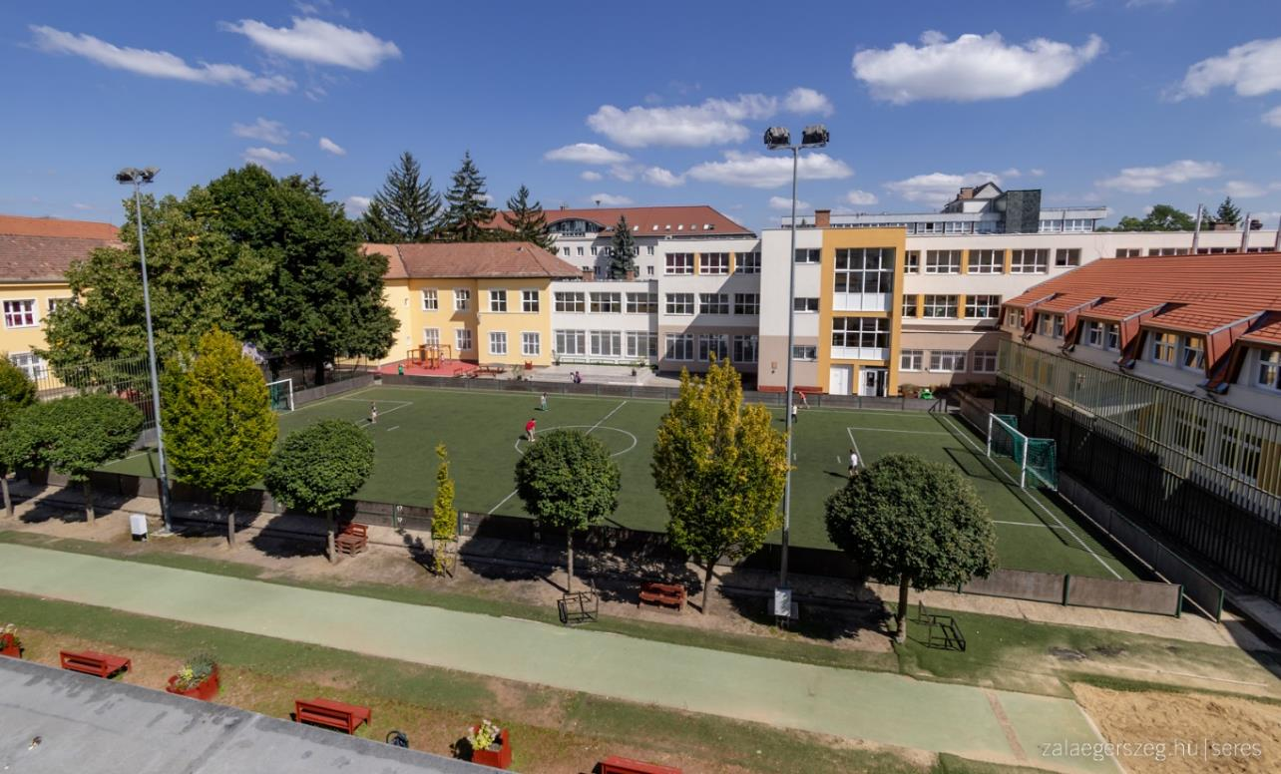
Notes:
Image source: Zalaegerszeg. (2026, January 12).
https://zalaegerszeg.hu/wp-content/uploads/2023/09/ESP_6270.jpg

Slide 44
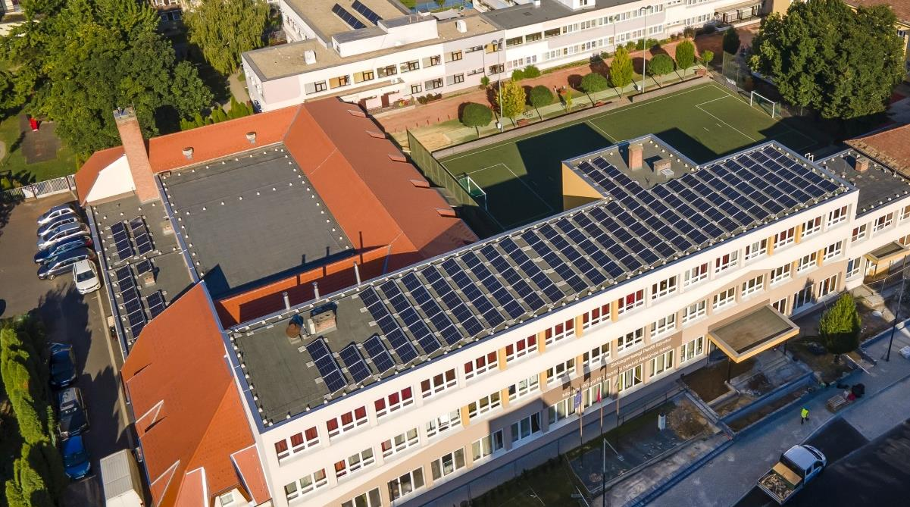
Notes:
Image source: Own photo.

Slide 45
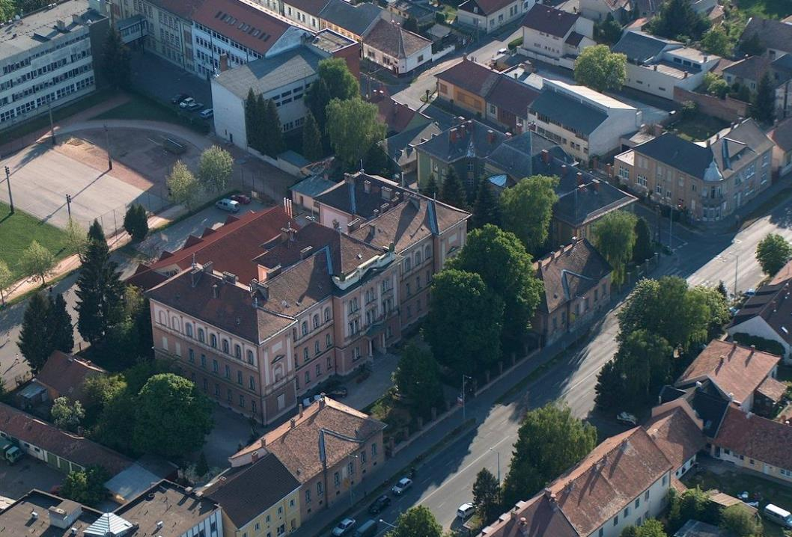
Zrínyi Miklós Grammar School
Notes:
Image source: Zalaegerszegturizmus. (2026, January 12).
https://zalaegerszegturizmus.hu/wp-content/uploads/2022/06/Zrinyi3.jpg

Slide 46
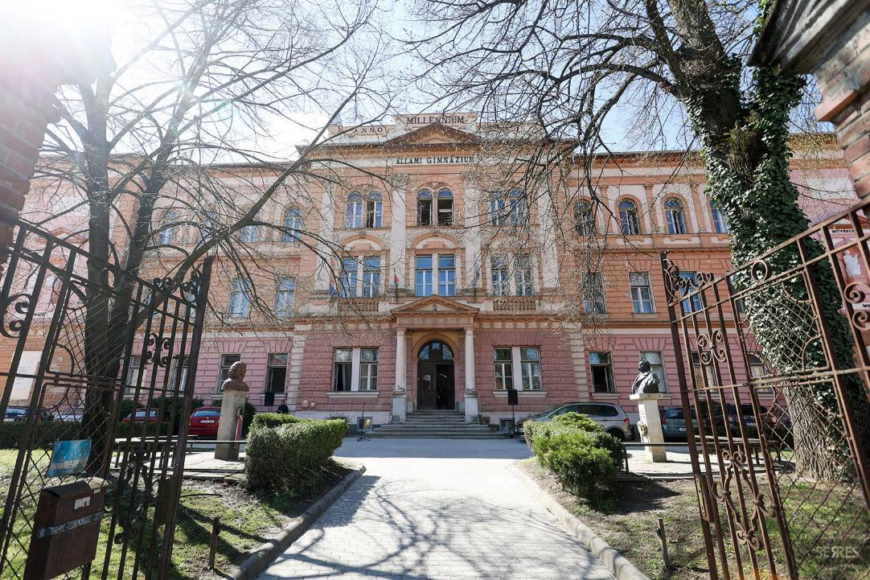
Notes:
Image source: Zalaegerszegturizmus. (2026, January 12).
https://zalaegerszegturizmus.hu/wp-content/uploads/2022/06/Zrinyi1-1600x1067.jpg

Slide 47

Some pictures of ZalaZone introductory slides (The main sponsor of 2027 conference)
Notes:
Slide courtesy of ZalaZone Ipari Park Zrt. (2026).

Slide 48

Notes:
Slide courtesy of ZalaZone Ipari Park Zrt. (2026).

Slide 49

Notes:
Slide courtesy of ZalaZone Ipari Park Zrt. (2026).

Slide 50

Notes:
Slide courtesy of ZalaZone Ipari Park Zrt. (2026).

Slide 51

Notes:
Slide courtesy of ZalaZone Ipari Park Zrt. (2026).

Slide 52

Notes:
Slide courtesy of ZalaZone Ipari Park Zrt. (2026).

Slide 53

Thank you for your attention!
Image sources are listed in the slide notes.
Notes:
Image source: Altengt. (2026, January 12).
https://www.altengt.com/images/automotive_funcational_safety/functional_safety_s.jpg

